Slide 1
© 2019 Feel Good Family Ltd.
How to promote healthy choices that grow your food business
f

Slide 2
A Passion to Make a Difference
This short movie sums up why Feel Good Family are so
passionate about making a difference.
Meet Jim, the character in the Rewind the Future video. He is a man whose life flashes right before his very eyes, unhealthy habits and all. The choices we teach our children today become the habits they take into their adulthood.
https://www.youtube.com/watch?v=xUmp67YDlHY
Children’s Healthcare of Atlanta Strong4Life, 2013
Notes:
Quite simply this short movie sums up why our team are passionate about wanting to make a difference

Slide 3
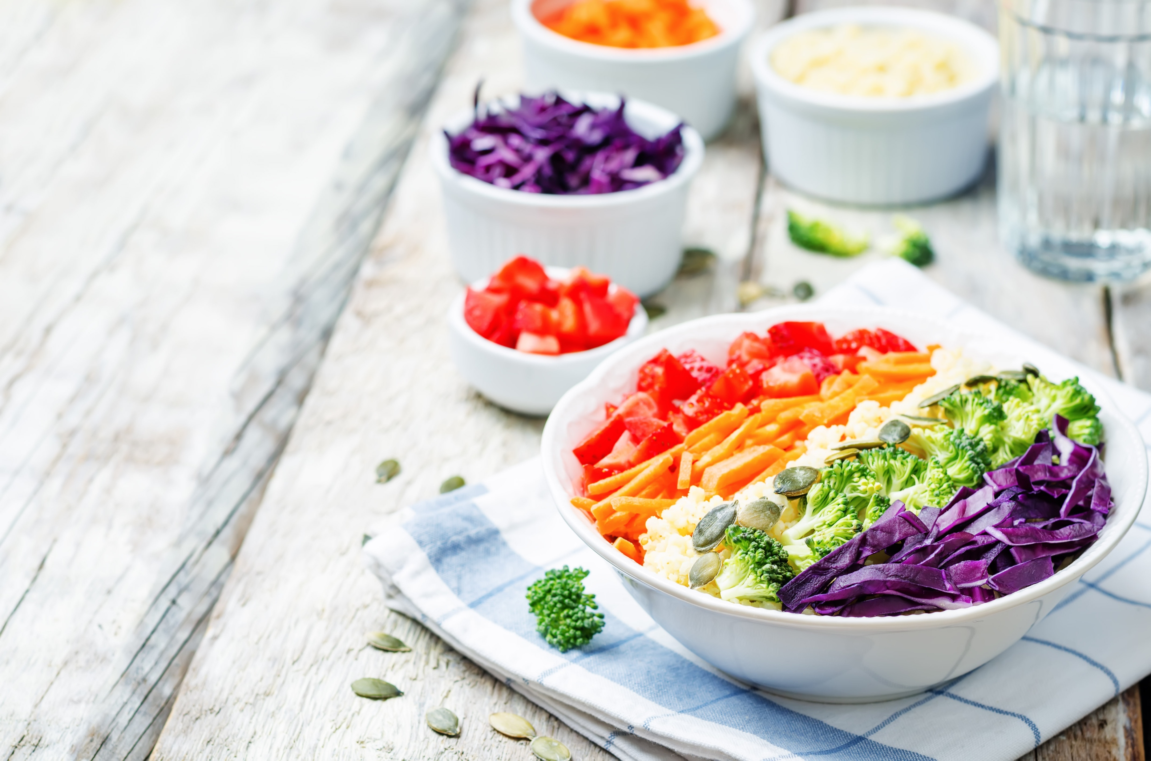
Our relationship with food is broken…
Information overload
Fads and trends
‘Orthorexia’ unhealthy obsession around healthy food including via social media
Label trust
Food guilt
Body image
Notes:
The current fashionable ‘health’ narrative
Gluten free, raw food, clean eating… a certain amount is ok, but it alienates the majority of people.
The trend for ‘Orthorexia’ - an unhealthy obsession around healthy food – e.g. eating gluten free when not required. We know that Orthorexia is an extreme condition and can be debilitating and effect lives (anxiety, stress, impacting on relationships), and not everyone who has a focus on healthy food is Orthorexic. However, it is an increasing trend that is being fueled by social media. People can have unhealthy and obsessive relationships with food without being fully Orthorexic.
Fads and trends
Rise of celebrity chefs and food blogs
Health is aspirational instead of realistic
Guilt and vilification of foods, such as sugar. Guild association being tied to looking a certain way.
Clean eating Instagram (32m posts) – The world of beautiful people. Messages around beauty and being thin.
Bodyism café in London – sugar is a toxin, being overweight is unhealthy
Extreme instead of being for everyone to live by
Two extremes

Slide 4
The Statistics
In the UK in 2007:
3 million adults had Diet Related Malnutrition (DRM).
Cost £13 billion annually.
10% of UK expenditure on health and social care.
Elia & Stratton (2009)
In the EU 20 million are affected with DRM, costing €120 billion annually.
Freijer et al. (2012)
Worldwide data:
1975 105 million people were obese.
By 2014 this reached 641 million.
Imperial College London
By 2030 estimates are over half the world population will be obese.
McKinsey Global Institute
Obesity is one of the top 3 social burdens generated by human beings, costing $2 trillion per annum.
McKinsey Global Institute (MGI) Overcoming Obesity: an initial economic analysis (Dobbs et al.2014)
Notes:
Elia M & Stratton RJ (2009) Calculating the cost of disease-related malnutrition in the UK in 2007 (public expenditure only). In Combating Malnutrition: Recommendations for Cost of malnutrition in Ireland 1971 Action. Report from the Advisory Group on Malnutrition, Led by BAPEN. Redditch: BAPEN.
Freijer K¹, Tan SS, Koopmanschap MA, Meijers JM, Halfens RJ, Nuijten MJ. (2013) The economic costs of disease related malnutrition. Clin Nutr. 2013 Feb;32(1):136-41. doi: 10.1016/j.clnu.2012.06.009
Trends in adult body-mass index in 200 countries from 1975 to 2014: a pooled analysis of 1698 population-based measurement studies with 19·2 million participants. The Lancet VOLUME 387, ISSUE 10026, P1377-1396, APRIL 02, 2016
McKinsey Global Institute (2014). Overcoming obesity: An initial economic analysis. Discussion paper. https://www.mckinsey.com/~/media/McKinsey/Business%20Functions/Economic%20Studies%20TEMP/Our%20Insights/How%20the%20world%20could%20better%20fight%20obesity/MGI_Overcoming_obesity_Full_report.ashx

Slide 5
What’s the future trend? Price Water House Coopers Study 2016
Respondents who say they are “moving towards a healthier diet”:
47% of 18-34 year olds in 2016; estimated to be 53% in 2017.
23% over 55s in 2016; estimated to be 19% by 2017.
"Most people want to mix and match, balancing healthy eating with the occasional indulgence.”
“Consumers are more likely to have healthy meals out during the week, driven by these being more everyday eating out occasions, and are more likely to treat themselves at weekends.”
Notes:
PwC Report: Healthy eating is increasingly on consumer’s agendas, with millennials leading the way
1000 people
There is a demand for healthy foods, but often they are not obvious or not available
There is customer demand for healthier food options
http://pwc.blogs.com/press_room/2016/08/healthy-eating-is-increasingly-on-consumers-agendas-with-millennials-leading-the-way.html

Slide 6
Future trend continued
Eating out, 47% of all consumers consider it important that a restaurant offers healthy options.
There are a range of ‘healthy’ food-to-go operators targeting the mid-week lunch occasion where people are more likely to focus on eating healthily.
Food operators are now focusing more on freshness and provenance given its importance to consumers when eating out.
Notes:
PwC Report: Healthy eating is increasingly on consumer’s agendas, with millennials leading the way
There is a demand for healthy foods, but often they are not obvious or not available
There is customer demand for healthier food options
http://pwc.blogs.com/press_room/2016/08/healthy-eating-is-increasingly-on-consumers-agendas-with-millennials-leading-the-way.htmlcs

Slide 7
Behavioural science: the evidence?
Changing a self-service buffet layout increased uptake of fruit and vegetables from 19% to 33%.
Items positioned in the middle at eye level are selected nearly 300% more than when on the left.
Reducing plate sizes and serving tongs reduced food waste by 20% in a study of a hotel chain in Norway.
Making healthier options more prominent increased sales by 11% in a two-year study in a hospital cafeteria in the USA.
Notes:
Kongsbak, I., Skov, L.R., Nielsen, B.K., Ahlmann, F.K., Schaldemose, H., Atkinson, L., Wichmann, M., and Perez-Cueto, F.J.A., (2016). Increasing fruit and vegetable intake among male university students in an ad libitum buffet setting: A choice architectural nudge intervention. Food Quality and Preference, 49, pp. 183-188. https://doi.org/10.1016/j.foodqual.2015.12.006
Keller, C., Markert, F. and Bucher, T., (2015). Nudging product choices: The effect of position change on snack bar choice. Food and Quality Preference, 41, pp. 41-43. https://doi.org/10.1016/j.foodqual.2014.11.005
Kallbekken, S. and Sælen, H. (2013). ‘Nudging’ hotel guests to reduce food waste as a win–win environmental measure. Economic Letters, 119(3), pp. 325-327. https://doi.org/10.1016/j.econlet.2013.03.019
Thorndike, A.N., Riss, J., Sonnenberg, L.M., and Levy, D.E. (2014). Traffic-Light Labels and Choice Architecture: Promoting Healthy Food Choices. American Journal of Preventive Medicine, 46(2), pp. 143-149. https://doi.org/10.1016/j.amepre.2013.10.002

Slide 8
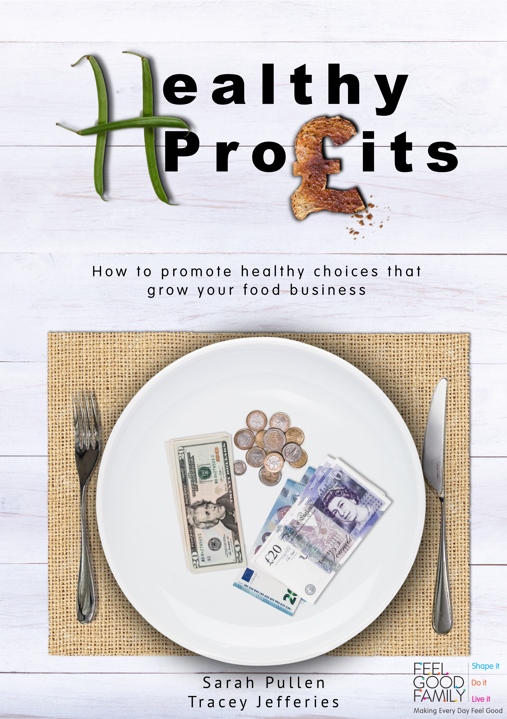
© 2019 Feel Good Family Ltd.
What are you waiting for?
With our book you can find out how you can change customer eating behaviours by shaping the opportunities, marketing and motivation in your food environment.
This leads to more money for you, and healthier customers too!

Slide 9
Chapter 1 Why Healthy Profits?
© 2019 Feel Good Family Ltd.
How we make food choices.
Which customers to focus on.
The approach to applying behavioural science.
At the end of this chapter you will have a clear understanding of behavioural science and its role in healthy eating.
How to promote healthy choices that
grow your food business

Slide 10
Chapter 2 Know your customer
© 2019 Feel Good Family Ltd.
Consumers and their eating behaviours.
Gathering customer feedback.
The importance of applying behavioural science slowly.
At the end of this chapter you will be equipped with the tools you need to get to know your customers better.
How to promote healthy choices that
grow your food business

Slide 11
Chapters 3, 4 & 5 - Reinvigorating your food and drink offer - Placement, presentation and convenience of food and drink - Shaping behaviour through menus
© 2019 Feel Good Family Ltd.
Appropriate behavioural science techniques to apply in your business backed by clear evidence and research.
Re-invigorating your food and drink offer.
Presenting and relocating healthier foods to increase take up.
Menus and how these influence consumers.
By the end of these three chapters you will know what approaches you can apply in your business.
How to promote healthy choices that
grow your food business

Slide 12
Chapter 6 Other ways to influence the purchasing experience
© 2019 Feel Good Family Ltd.
How to tell your food story.
Using verbal nudging.
Rewards and role modelling.
Why everything matters.
By the end of this chapter you will understand more about a range of other factors that can influence the wider purchasing experience.
How to promote healthy choices that
grow your food business

Slide 13
Chapter 7 Implementing your ideas and measuring success
© 2019 Feel Good Family Ltd.
Bringing your team with you.
Measuring success, what to measure and how often.
How to develop a plan using our helpful checklist.
By the end of this chapter you have all the tools you need to help you succeed.
How to promote healthy choices that
grow your food business

Slide 14
Chapter 8 Case studies
© 2019 Feel Good Family Ltd.
Including hotel restaurant, workplace canteen, takeaway, pub, primary school and secondary school.
Whatever your food business environment, these case studies will stimulate ideas to apply in your own setting.
How to promote healthy choices that
grow your food business

Slide 15
Exclusive resources
© 2019 Feel Good Family Ltd.
By buying our book you get exclusive access to useful resources like our Healthy Profits checklist, case studies and action plan templates to name just a few!
Follow us on social media where we regularly share tips and ideas:
Twitter @feelgood_family and @healthy_profit
Facebook @healthyprofitsfgf
Instagram @healthy_profits as Tracey sails around the world finding out how feel good healthy foods are promoted overseas.
LinkedIn https://www.linkedin.com/showcase/healthy-profits/
If you want more support, email us at info@feelgoodfamily.co.uk and we will get right back to you. Our accredited Healthy Profits workshop is also available if you want to develop a tailored plan for your business with support from us. Get in touch for more details.
How to promote healthy choices that
grow your food business
Notes:
Healthy Profits workshop https://feelgoodfamily.co.uk/healthy-profit-workshop-behaviour-change-training/

Slide 16
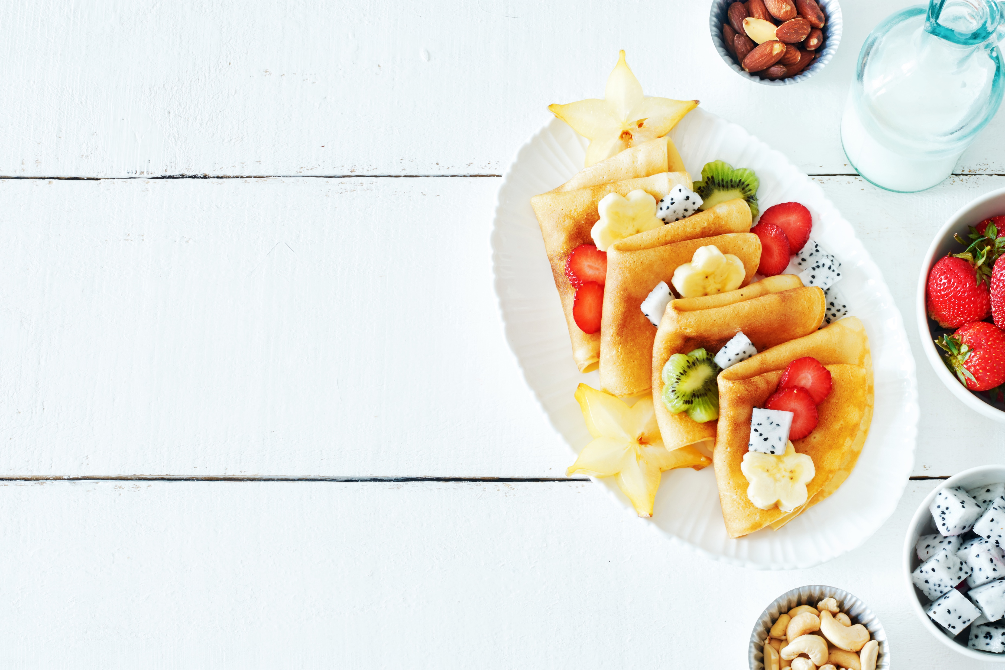
Consumers views on food descriptors
Look out for Super Yummy! Our next book in the series Coming in 2020…
We gather the evidence, do the research and create the resources, so you don’t have to!
Notes:
Super Yummy! is one of many resources we are developing to make it easier to shape the food choices of your customers, whilst increasing profits and customer loyalty. It is a book to make naming foods on menus easy, and make healthy options sound delicious and tempting
Researching food descriptors
Identify descriptive words to make Feel Good Food more appealing to everyone
Focus groups all ages presented with a range of word types and open discussion
Wider survey underway
Super Yummy Book 2019
Marketing and branding, most convenience foods scour restaurants for food descriptors

Slide 17
A sneak peak into our findings…
Notes:
Feel Good Family research 2017 www.feelgoodfamily.co.uk

Slide 18
What consumers said about labelling
Lack of compliance in smaller retailers.
Clever marketing portrays junk food as healthy.
There are always loopholes in regulations.
The use of meaningless, ambiguous and misleading language (e.g. science claims).
82.4% said they trusted Government labelling (e.g. Government health initiatives).
Notes:
There is a demand for healthy foods, but often they are not obvious or not available
There is customer demand for healthier food options
Feel Good Family research 2017 www.feelgoodfamily.co.uk

Slide 19
What consumers said…
88% of consumers have a preference to select locally produced foods.
84% stating this was to support local producers.
54% stating food miles were important.
13% more consumers stated it was very important to buy British food after Brexit – a rise of 6%.
81% of consumers state recommendation as the key influencer in restaurant choice.
12.8% of consumers do not know enough about food to know what’s in season in the UK.
Notes:
There is a demand for healthy foods, but often they are not obvious or not available
There is customer demand for healthier food options
Feel Good Family research 2017 www.feelgoodfamily.co.uk

Slide 20
Takeaways and portion sizes
77% of consumers want takeaways that are healthier, but still tasty and filling.
Just 55% of respondents think healthy food portion sizes are about right, with 27% thinking they are too small.
78% of consumers say portions of unhealthy food are too large, or far too large.
Notes:
There is a demand for healthy foods, but often they are not obvious or not available
There is customer demand for healthier food options
Feel Good Family research 2017 www.feelgoodfamily.co.uk

Slide 21
Find out more:
Web www.feelgoodfamily.co.uk
Twitter @feelgood_family and @healthy_profit
Facebook @healthyprofitsfgf
Instagram @healthy_profits as Tracey sails around the world finding out how feel good healthy foods are promoted overseas.
LinkedIn https://www.linkedin.com/showcase/healthy-profits/
Email us at info@feelgoodfamily.co.uk
Our accredited Healthy Profits workshop is also available if you want to develop a tailored plan for your business with support from us. It is also a great CPD opportunity. Get in touch for more details.
Start growing healthy profits!
Notes:
You can buy a copy of our Healthy Profits book at https://feelgoodfamily.co.uk/book/healthy-profits-book/ and visit our website www.feelgoodfamily.co.uk to find out more about us. By buying our book you get exclusive access to useful resources like our Healthy Profits checklist, case studies and action plan templates to name just a few!
Healthy Profits workshop https://feelgoodfamily.co.uk/healthy-profit-workshop-behaviour-change-training/

